Slide 1
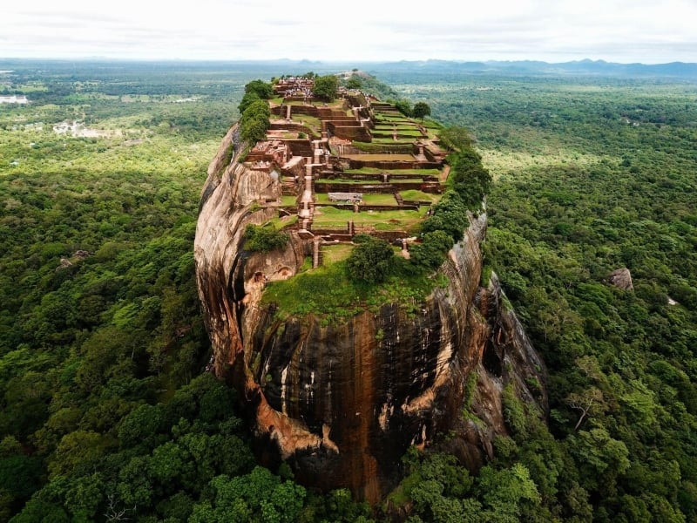
Visit Sri Lanka

Slide 2
Based on Nutrition
Ascomycetes
Basidiomycetes
Deuteromycetes
Zygomycetes
Phycomycetes
01.
02.
03.
04.
05.

Slide 3
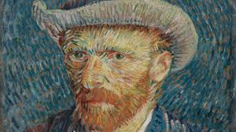

Slide 4
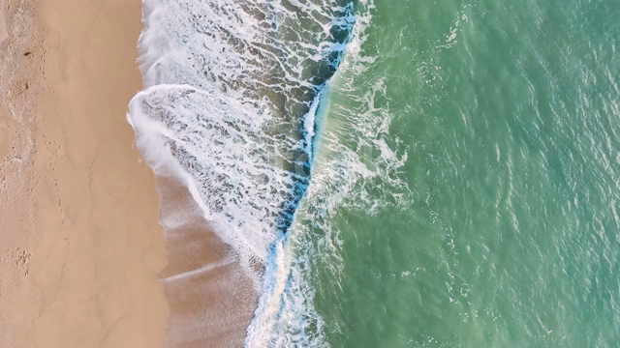
11/05/2024
COX’S BAZAR
Saturday

